Slide 1
Real-time passenger location estimation
using CDRs and train objects
generated from crowdsourced timetables
PURBA 2015 @ Osaka
September 7, 2015
Shibasaki & Sekimoto Lab.
The University of Tokyo
Takuya KANNO†
Hiroshi KANASUGI
Yoshihide SEKIMOTO
Ryosuke SHIBASAKI
†Master student, Graduate School of Frontier Sciences
Notes:
Thank you, Mr. Chairperson. Good morning, ladies and gentlemen.
My name is Takuya Kanno,
I’m a master course student at Shibasaki and Sekimoto Lab. in The University of Tokyo.
This is my first time to make a presentation at the international conference.
Please go easy on me ☺

Slide 2
Contents
Background
Problem
Purpose
Using data
Method
Results
Future vision

Slide 3
Background - 1
As social needs, Survey of people flow in micro level is required
disaster management, transportation management
Transportation mode has own characteristic
Train : departure time is determined in advance

Slide 4
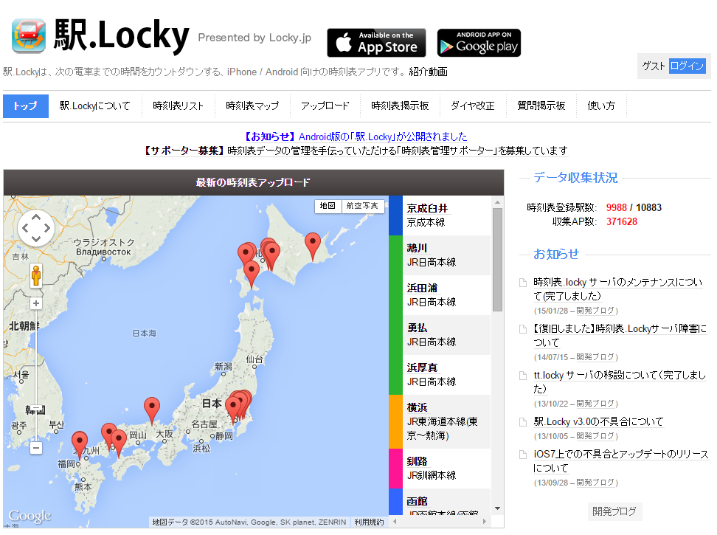
Background - 2
-Emerging technology
CDR^{※1}
Ishizuka et al. detected train commuters using CDRs and GIS information^{※2}.
Crowdsourced train timetable – “Eki.locky”
A smartphone timetable application developed by Kawaguchi et al^{※3}.
Timetable information is created by registers & shared with all users.
※1 Call Detail Records
※2 H. Ishizuka, N. Kobayashi, S. Muramatsu, C. Ono. 2015. Detecting train commuters using CDRs and GIS information. NetMob2015 book of abstracts::posters, pp.39-41, 2015
※3 http://eki.locky.jp/site/top
Notes:
Next, a crowdsourcing type timetable database called “Eki.locky” already exists in Japan.
“Eki” is the Japanese word for “Station.”
Eki.Locky is a smartphone train timetable application developed by Kawaguchi et al.
This application displays the time for the departure of the next train.
Timetable information is created by registers & shared with all users.
If the required station timetable has not yet been registered, anyone can create and upload the timetable file.
Further, all users are able to access the timetable provided in the application.
This is the method used to obtain the timetable data.
The timetable information covers 91% of the stations in Japan (about 10 thousand stations).
However, timetable doesn’t have location information as latitude-longitude coordinate system.
--
The rest is mainly expired timetables in local areas. Timetable data are stored in NextTrain format. This service’s web page URL is http://eki.locky.jp/site/top.

Slide 5
Problems
Which train a passenger is riding : unknown.
CDR has low spatiotemporal resolution.
Crowdsourced train timetable does not have spatial information e.g. latitude/longitude.
Notes:
Therefore, the problems are following 3.
1st, spatiotemporal resolution of CDR is low, especially compared with GPS.
2nd, which train a passenger is riding is unknown.
3rd, Crowdsourced train timetable does not have latitude-longitude information, but could be source of simulating train operation by spatial information processing.

Slide 6
Purpose
Our research builds on above research to detect which train a passenger is riding using CDRs and Train Object created from crowdsourced train timetables.
specifically-
Generate train objects from crowdsourced timetable information
Estimate riding train by calculating likelihood
Notes:
Therefore, the purpose is set to build on above research to detect which train a passenger is riding
using CDRs and Train Object created from croudsourced train timetables.
more specifically, there are 2 points.
One is to Generate train objects from timetable information
The other hand is to Estimate riding train by calculating likelihood

Slide 7
Using data - CDR (Call Detail Record)
Record of calls and data communications
Data format
No information about communication type call or data
People ID (anonymously)
Time
Antenna Latitude
Antenna Longitude
Time
Antenna Latitude
Antenna Longitude
•Survey period: February 2013 (1 month).
•Acquired data: CDRs and GPS logs.
•Number of samples: 48 persons
•Average communication interval of CDRs: 2.9 min
Beginning of communication
End of communication
Notes:
Here, I’d like to enter the concrete part.
explain Call Detail Record used in this research.
As you know, CDR is Record of calls and data communications of mobile phone.
Data format of CDRs in this research is shown: anonymously people ID, Time, Antenna Latitude and Antenna Longitude of beginning of telecommunication,
the same of end of telecommunication.
This CDRs are provided in cooperation with KDDI R&D Laboratories.

Slide 8
CDRs and Target rail lines in this research
-The Tokyo metropolitan railway network (blue lines)
-Mobile phone base station (orange triangles).
Notes:
This Figure shows base station’s location of CDRs and target railways of estimating train object.
Bold blue railways are the lines targeted in this research.
Please note that these base stations are included in only this survey’s CDRs, not all base stations in this area.

Slide 9
Method - Detect commuting trip
CDR
trip
Clustering stay points※
Set trip between stay points
trajectory
Detect trip intersect 8 a.m.
・Average attendance time is 8:26（Ministry of Internal Affairs and Communications survey, 2001）
・Average commuting time based on questionnaire in this survey : 47min.
※ Kanasugi. H, Sekimoto. Y, Kurokawa. M, Watanabe. T, Muramatsu. S, Shibasaki. R, 2013, Spatiotemporal Route Estimation Consistent with Human Mobility Using Cellular Network Data, Proceedings of PerMoby2013, pp.267-272
Notes:
Next, I’d like to explain the method of detecting CDR trajectory in commuting trip.
First, there are row CDRs.
Next, stay points are clustered by Kanasugi et al method. Red point are stay points.
Then, trips are set between stay points.
last, trips intersect 8AM are detected as commuting trips.
This is the end of explanation of CDRs.

Slide 10
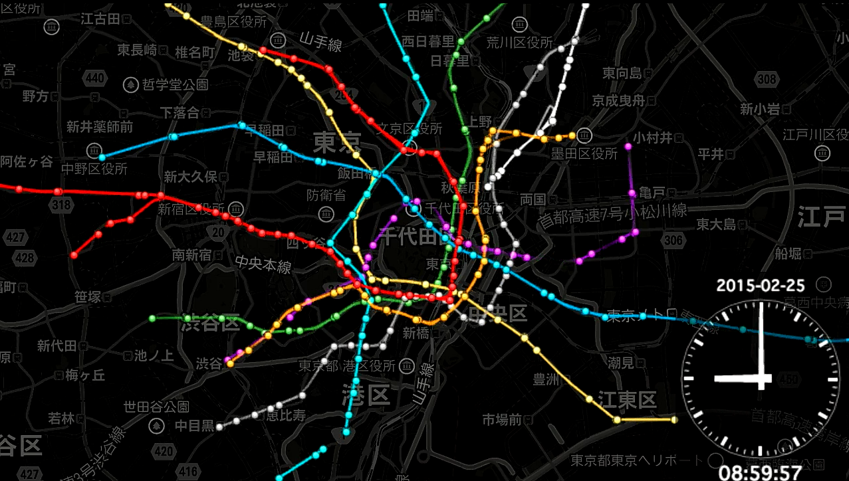
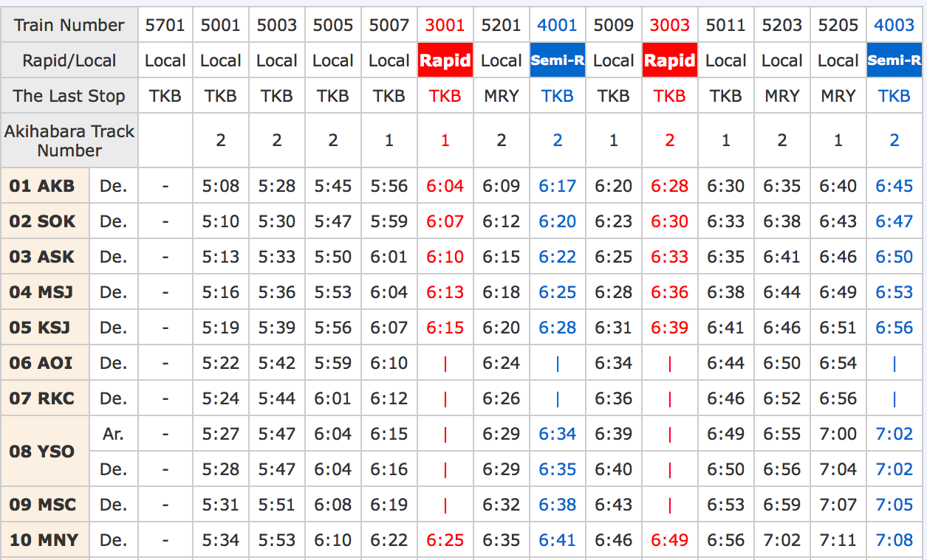
Method - Generate train objects from timetable information
Station Timetables
Individual train schedules
Individual train objects
reconstructing the departure time
of the same train
geocoding station location and interpolate every minute
between the stations
Station 1
Station 2
Station 3
Notes:
Next, I’d like to explain the method to generate train objects from timetable information.
First, there are individual station timetables.
Second, Timetables for each train are generated by reconstructing the departure time of the same train from the timetable information of each station.
The station location is geocoded because the timetable does not include the station location on GIS, only the station name.
The latitude and longitude of trains are interpolated every minute between the stations using the shape data of the routes, based on the assumption that the train is moving at a constant speed.
In this way, the moving data - [time every minute, latitude, longitude] for each train object are generated from the timetable.
This figure shows Train objects of Tokyo metro at a particular moment.
Each color represents a different railway. Approximately 20 train objects are running at the same time on each route.

Slide 11
Train objects
Notes:
This is movie of train objects in Tokyo.
In this file, train speed is constant but stay 30 seconds at each station.
Big circle is visualizing problem because a lot of train object start and end that station
there are 40 thousand train objects in Tokyo metroporitan in one day.

Slide 12
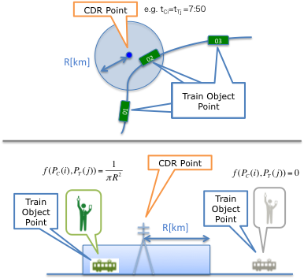
Estimating Method of the riding train object from CDRs
Likelihood calculation of the passenger for individual train is conducted. –expression(1)
The probability of cell phone existence is defined as a uniform distribution within concentric circles from the cell tower. –expression(2)
correction
Notes:
Next, I’d like to explain the method to estimate the riding train object from CDRs based on likelihood function.
Quite simply, calculate probability based on distance between CDR location and train object location in trip trajectory.
concretely,
At the moment when a CDR is observed, calculate the distance between the train objects and the cell tower of the CDR.
The probability of cell phone existence is defined as a uniform distribution within concentric circles from the cell tower.
Then, likelihood calculation of the passenger riding the train is conducted.
For the sensitivity analysis, calculate the likelihood by changing the radius R as 2, 3 , 4 km.
Here, I’d like to correct the expression 2.
ε is sufficiently small number.
In the paper, ε was 0.
I am sorry for expression mistake.
円内にいるとき、式2は1-ε/Pie R square
塩害にいるとき、ε

Slide 13
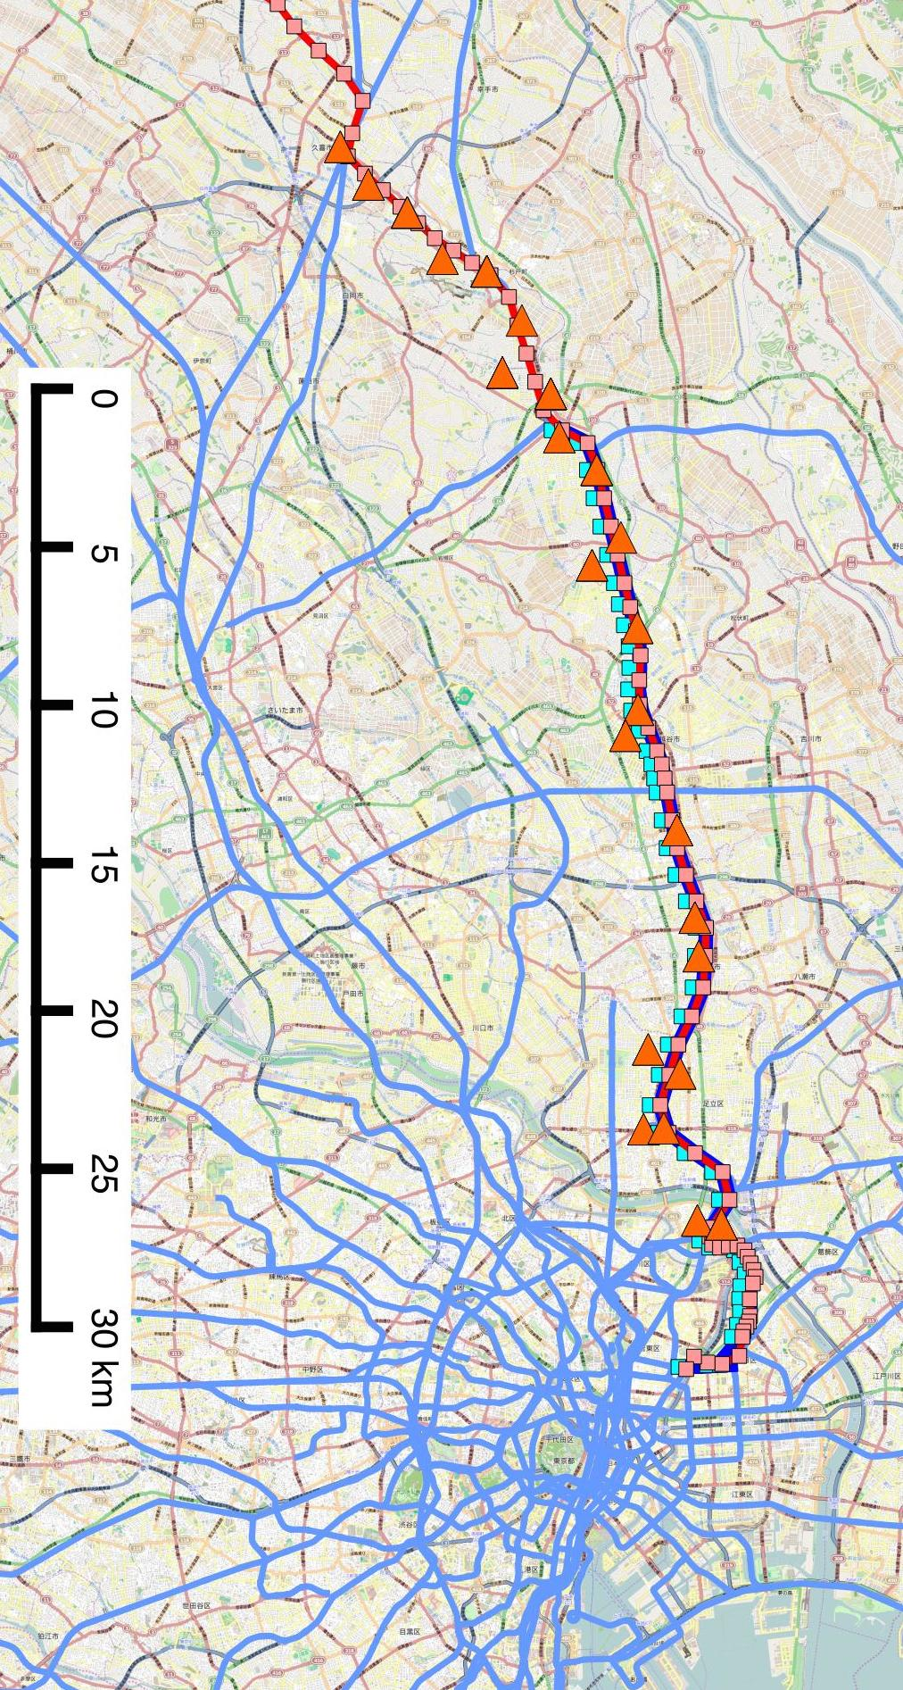
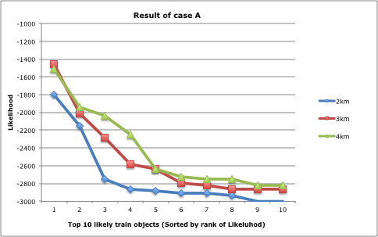
Results – case of good estimation
One trip of certain sample
successful estimation results
There were 85 CDR points.
Top three highest likelihood train objects within each radius. The actual train being ridden, as specified by GPS logs, is TI54.
The graph shows the likelihood L of each radius. Top 10 likelihood values for the train object.
Notes:
Next, I’d like to explain the results.
This is case of good estimation.
This graph shows the likelihood L of each radius.
Top 10 likelihood values for the train object.
Right table shows top three highest likelihood train objects within each radius.
The actual train being ridden, as specified by GPS logs, is TI54.
A large difference in the likelihood values exists in the top five train objects. The difference between the remaining objects is small.
In this case, the maximum likelihood estimation is correct for each radius
★click
The CDR trajectory in this trip and train objects are shown in this figure.
However, the figure could not express the temporal transition, I made the movie.

Slide 14
●CDR
●GPS
●Train object
Notes:
CDRのcommuting trajectory は途中から始まる。TI54と沿って動く。
途中、TI85とも近いように見えるが、乗換えないと仮定すると、運行区間からTI54と推定できる。

Slide 15
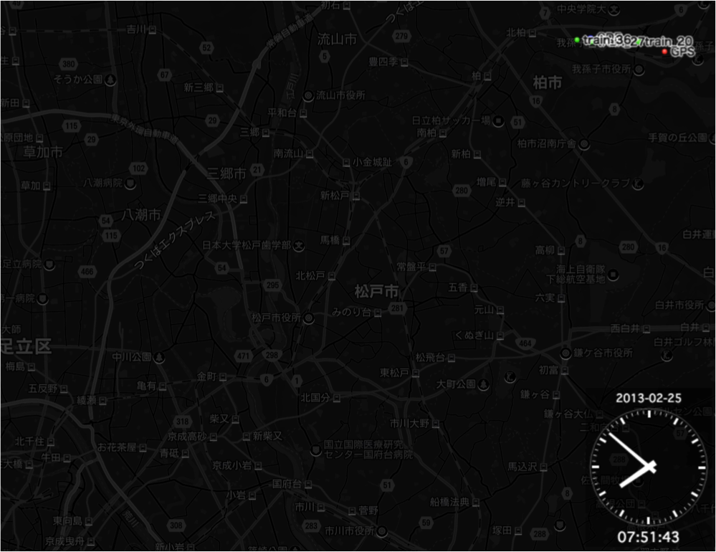
Results – case of bad estimation
●CDR
●GPS →train_20
●Train obj
GPS: train_20
R=3: train_20
R=4: train_27
considerable reason
constant speed
no stop at station
perhaps delay
Notes:
This is case of bad estimation.
The actual train being ridden, as specified by GPS logs, is JF27.
estimated most likely train in radius = 4km is JF27, corresponded.
However estimated most likely train in 3km is JKs20, not corresponded.
Under the assumption of constant probability of occurrence of communication within the circle, the result of the likelihood calculation changed according to the radius distance.
considerable reasons are 3.
1st is train object is running constant speed,
2nd is train object don’t stop at station,
3 rd is train in real was delayed.

Slide 16
Conclusions and Future works
Conclusion
Real-time estimation of the train being ridden by a passenger using crowdsourcing type train object and smartphone CDRs was successful in cases where the CDRs had a wide ranging distribution.
not successful in cases also exists.
Future works
More extensive evaluation is required.
Increase target train and people
Improve the method of detecting the commuting CDRs trajectories
In addition, improvement of simulating train objects and estimation is required to deal with real train operation, train delay and passenger transfers.
Thank you for your kind attention.
Notes:
Thank you for your kind attention.
I am happy to answer any question that you might have.

